Slide 1
Statistical Factor Relative Value in Natural Gas Futures
PM: Solal Danan
Analyst: Shenghao Sun

Slide 2
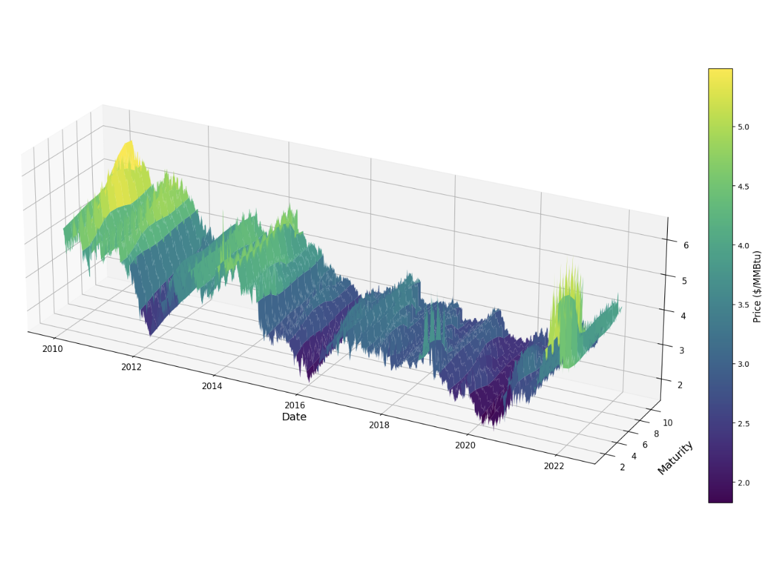
Investment Thesis & Data Universe
Framework: Factor Model, PCA & Target Definition
Feature Engineering & Preprocessing
Training Strategy & ML Pipeline
Signal Quality & OOS Evaluation
Model Analysis & Interpretability
Portfolio Construction & Backtesting
Conclusion

Slide 3
Investment Thesis
Statistical relative value on the Henry Hub futures curve
Strategy Objective: Build a market-neutral relative-value strategy on the NYMEX Henry Hub forward curve, trading constant-maturity contracts M1–M12. The objective is to identify which maturities are temporarily rich or cheap, rather than forecasting the outright gas price.
Alpha Hypothesis: Maturity-specific dislocations from the PCA-implied forward curve are partially predictable. These dislocations may become more predictable when storage constraints, weather shocks, and curve-state signals indicate stress in the natural gas market.
Core Mechanism: A rolling PCA removes common curve factors to isolate idiosyncratic residuals. A machine learning model then forecasts 5-day cumulative residual returns using storage, weather, curve-shape, and macro features. The resulting portfolio is dollar-neutral and factor-neutral.
Multi-source Data Integration
ML-Conditioned Forecasting
Market-Neutral Portfolio
PCA Factor Decomposition

Slide 4
Data Universe
Prices — Henry Hub Futures
Storage — EIA Weekly
NYMEX Henry Hub constant-maturity futures, daily settlements, 2010–2026 (LSEG).
Estimation Universe: M1-M12
Log-returns are roll-adjusted to remove mechanical month-end continuation bias.
U.S. underground working gas in storage, reported weekly by the EIA.
Captures the supply buffer of the gas market and the inventory-driven convexity of the futures curve.
Weather — HDD / CDD
Macro Controls
NOAA/CPC daily population-weighted CONUS temperature.
HDD and CDD proxy weather-driven gas demand:
HDD = max(65°F − T, 0) CDD = max(T − 65°F, 0)
Heating demand dominates winter risk; cooling demand captures summer power burn pressure.
Daily FRED and CBOE series capturing cross-asset, funding, and risk conditions.
WTI crude, TTF, EUR/USD, 3M T-Bill, S&P 500, VIX, OVX.

Slide 5

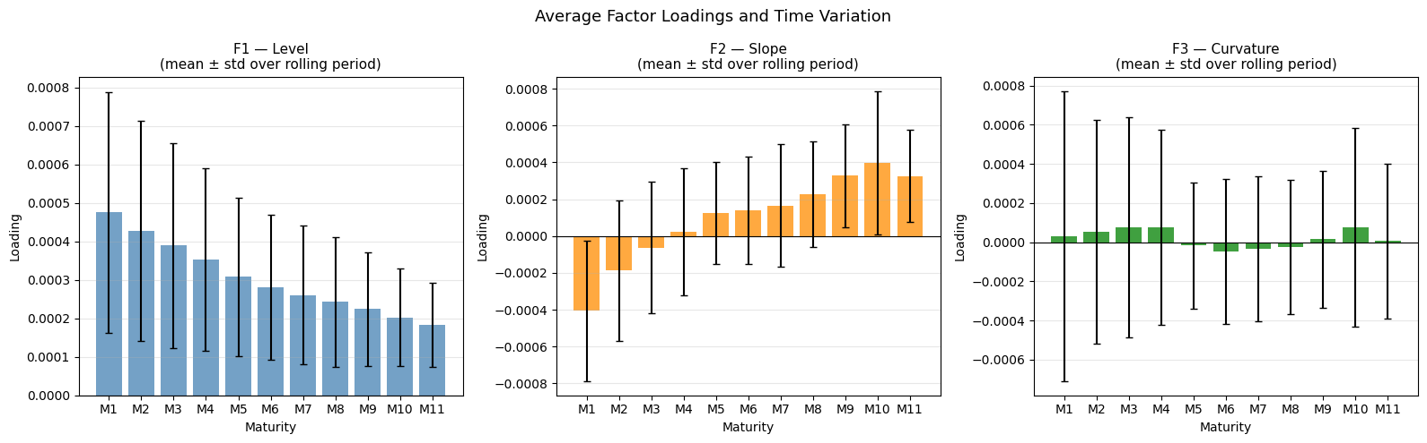
Factor Framework: Overview
Rolling PCA isolates common curve moves and leaves maturity-specific dislocations.
Objective:
Separate systematic curve moves from relative-value dislocations.
A residual for each maturity, used as the tradable signal.
Three interpretable latent factors:
Level — parallel movement of the curve
Slope — front vs. back tilt
Curvature — belly distortion

Slide 6



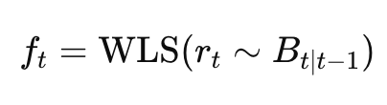
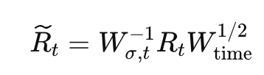
Factor Framework: Two-Stage PCA
A rolling two-stage PCA extracts stable curve factors while controlling for maturity-specific volatility.
Why two stages?
1. Recent data matters more: Rolling exponential weights adapt to regime shifts.
2. Maturities have different volatility: Front contracts are much noisier than back contracts.
3. Reweighting prevents noisy maturities from dominating PCA. The final factors capture curve structure, not volatility hot spots.
Stage 1 — Estimate idiosyncratic volatility
A fast decay weighted PCA is used to remove the first common curve components. The residual variance gives one volatility proxy per maturity.
Stage 2 — Reweighted PCA/SVD
Returns are scaled by inverse idiosyncratic volatility and slow time weights.
Statistical Factor Model :
daily returns=common curve factors + maturity-specific residual
rt: daily log-returns of M1–M12
Bt: factors loadings
ft: factor returns, WLS-fit at each date t
εt: idiosyncratic residual — the maturity-specific dislocation
Estimate rolling loadings B from past returns:
Then project each new return vector onto the factor space.

Slide 7
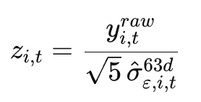
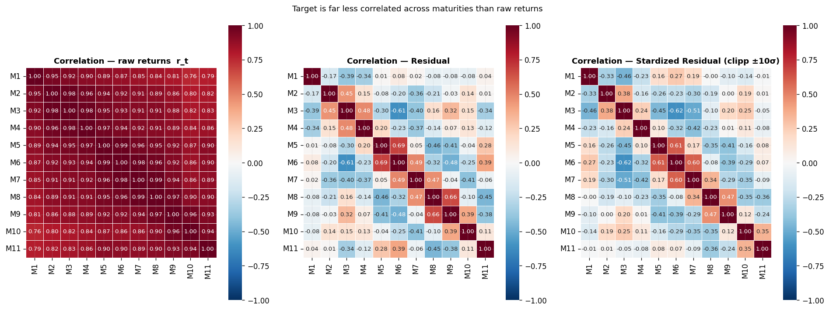
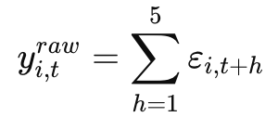
Target Variable
Predicting standardized residual returns aligns the ML target with a factor-neutral relative-value strategy.
Why residuals?
Target Standardization:
The target is standardized by trailing residual volatility, using information available at date t only.
The target is expressed in residual-risk units to make maturities comparable.
Trading interpretation:
z > 0 → maturity expected to outperform the factor-implied curve
z < 0 → maturity expected to underperform the factor-implied curve
Prediction target: 1-week cumulative residual return
Because log-returns are additive, summing daily residuals gives the next-week residual move.

Slide 8
Feature Engineering
~70 features grouped into 7 signal families — per-maturity (i,t) and date-level (t).
Family | Scope | Description
Curve Shape | Per maturity | Local slope and curvature at each point on the forward curve; deviation of contract from the curve mean; change in local slope.
PCA Residual Signal | Per maturity | Current idiosyncratic dislocation level and z-score; short-term mean-reversion tendency; residual relative to the cross-sectional average.
Factor Dynamics | Date-level | Level, slope, and curvature momentum and realized vol; explained variance ratio as a regime indicator.
Fundamental — Storage | Date-level | EIA weekly inventory vs. 5-year seasonal norm; unexpected weekly change; EIA announcement days.
Fundamental — Weather | Date-level | HDD / CDD deviation from 4-year climate baseline; ARMAX expected vs unexpected temperature; 5-day forecast shock vs seasonal average.
Macro & Cross-Asset | Date-level | Crude oil momentum; energy volatility regime; equity risk sentiment (VIX); funding conditions (T-Bill); TTF–Henry Hub & JKM-HH spreads.
Calendar | Per-Maturity | Month-of-year seasonality; injection vs withdrawal season flag; contract position along the curve

Slide 9
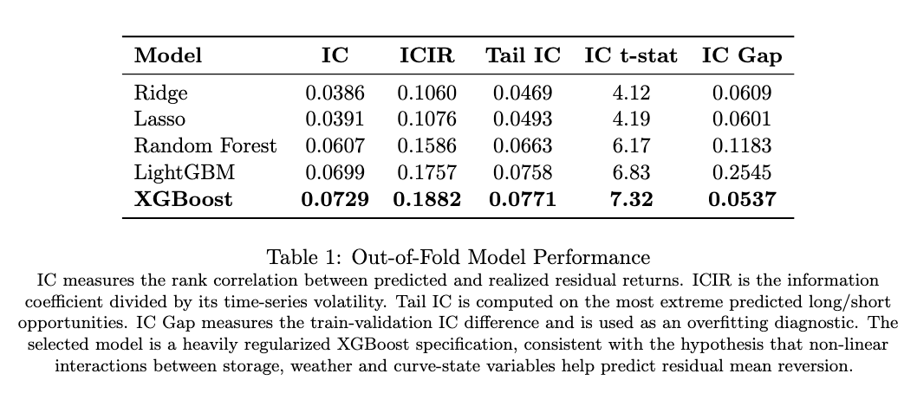
Training Strategy & Model Results
Walk-forward model selection with purged validation and out-of-fold IC evaluation.
Protocol
Preprocessing: Preprocessing: cross-sectional robust z-score by date; trailing z-score for time-series features.
Walk-forward CV with rolling 3-year training windows and quarterly refits.
Purge gap of h = 6 days to remove overlap induced by the 5-day cumulative target (break serial autocorrelation).
In-sample 2013–2022: model selection, feature selection, hyper-parameter tuning and portfolio sizing.
Out-of-sample 2022–2026: held out for final evaluation; no parameter touched after the cut-off.
Feature selection based on MDI and permutation importance.
Take-away:
The performance over Ridge/Lasso supports the non-linearity hypothesis.

Slide 10
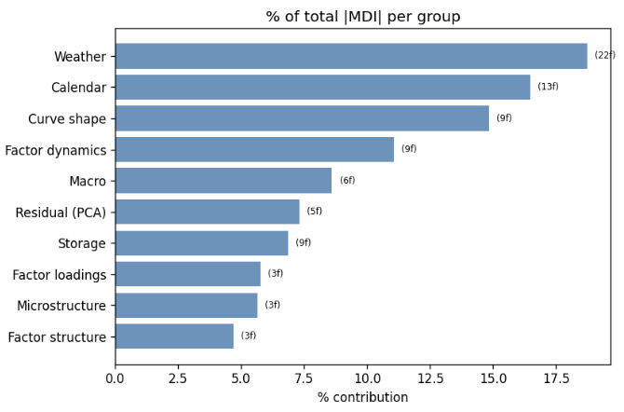
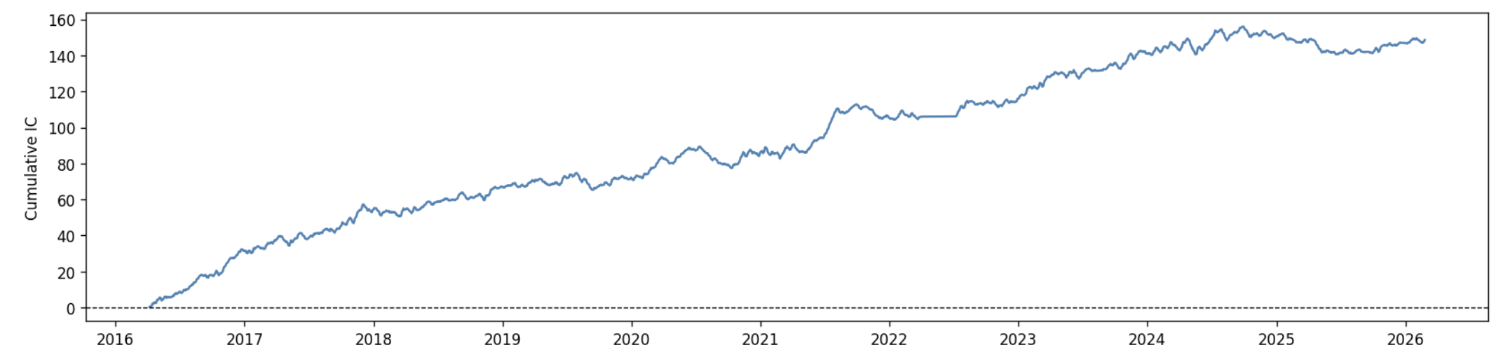
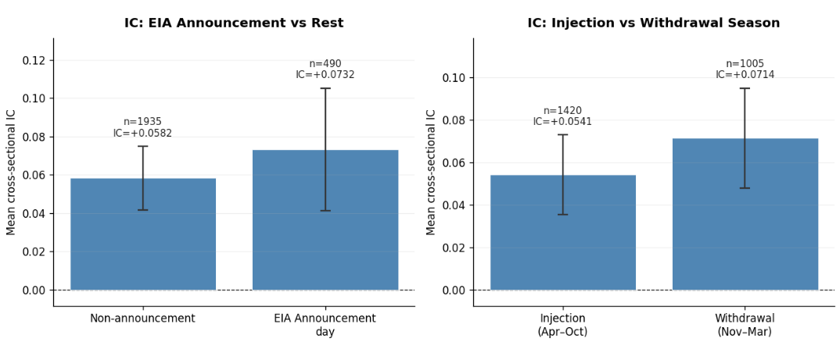
Model Analysis
Predictive power is concentrated in economically interpretable regimes and feature groups.
Weather, calendar and curve-shape variables dominate model importance.
Cumulative IC is upward-sloping, indicating persistent ranking skill.
Signal is stronger during withdrawal season and around EIA announcements.

Slide 11
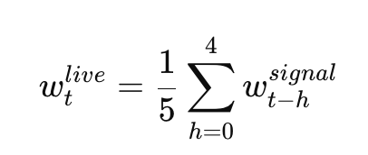
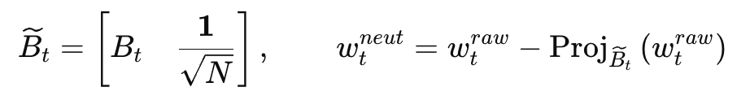
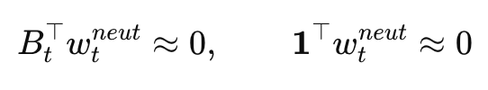
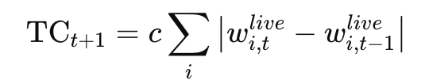
Portfolio Construction & Backtesting
Rank-based relative-value portfolio, factor-neutralization and explicit transaction costs.
Portfolio Construction
1. Universe
M2–M12 constant-maturity contracts; M1 excluded to reduce roll noise.
2. Ranking signal
Rank maturities by predicted standardized residual return.
3. Initial long/short book
Long top 4 maturities, short bottom 4 maturities, equal-weighted.
4. Risk controls
Gross exposure = 1.0; max position size = 25%.
5. Neutralization
Enforce dollar-neutrality and remove exposure to the first 3 PCA factors.
Protocol
Execution Timing (no lookahead)
Signal computed at close t --> Portfolio executed at close t+1.
Weights are lagged before PnL is computed.
Overlapping Sleeves (H = 5 days)
Each daily signal is held for 5 days; the live portfolio averages the 5 most recent sleeves.
Transaction Costs
2 bps one-way per unit of notional traded
Costs are charged on changes in live portfolio weights.

Slide 12
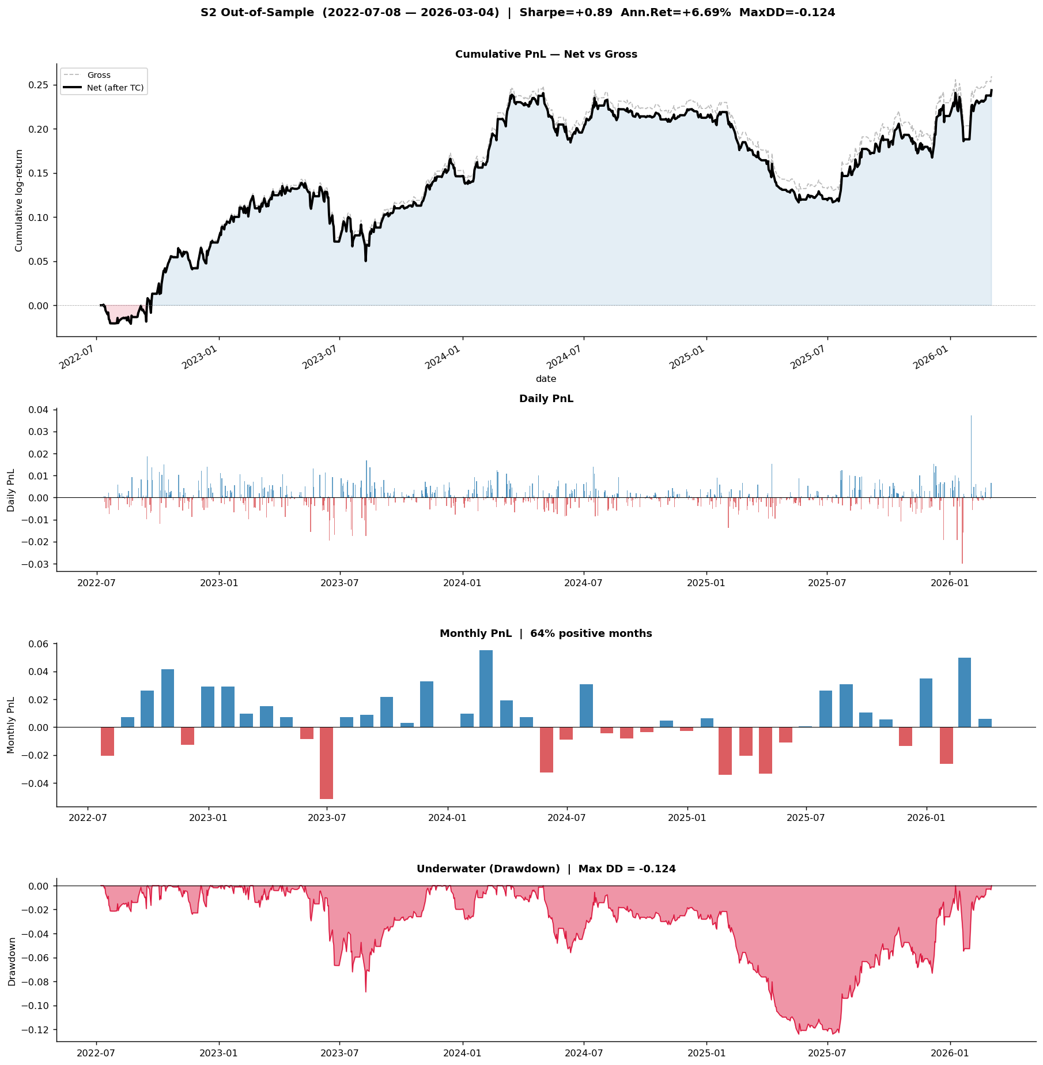
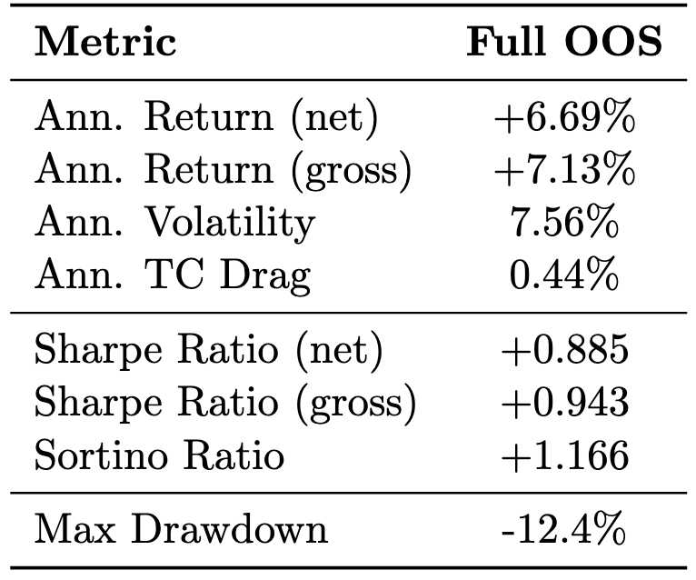

Out-of-sample Backtesting Results
July 2022 – March 2026 · 2 bps one-way transaction cost

Slide 13
Limitations & Next steps
The backtest provides encouraging OOS evidence of a residual-ranking signal after costs and factor neutralization, but further robustness work is needed.
Key Limitations
1. Structural break sensitivity
The model struggles during extreme market regimes. During COVID-19, highly correlated curve moves reduced cross-sectional dispersion and weakened residual signals.
2. Roll-date contamination
Roll adjustment significantly reduces continuation-series bias but end-of-month returns remain high.
3. Simplified portfolio construction
Current portfolio is rank-based. It does not yet adapt to contract-level volatility, liquidity or transaction-cost differences.
4. Overfitting risk
Although the selected XGBoost model has a low IC gap, the signal weakens in some sub-periods, suggesting regime-dependence and the need for further robustness testing.
Next Steps
1. Validate signal robustness
Test alternative horizons H ∈ {3, 5, 10}, roll-exclusion windows.
2. Rebuild on individual contract data
Move from constant-maturity continuation series to true tradable futures contracts to remove residual roll uncertainty.
3. Improve portfolio optimization
Replace equal-weight top/bottom selection with volatility-scaled or constrained optimization, including factor neutrality, liquidity caps and turnover penalties.
4. Missing physical flow information
Recent supply/demand dynamics are only partially captured. LNG flows, pipeline flows, power generation and production data could improve regime identification.

Slide 14
Questions?
Thank you for listening

Slide 15
References
[1] G. Paleologo (2025). Statistical Factor Model (Two-stage PCA). The Elements of Quantitative Investing
[2] Y. Chen (2023), Temperature, storage and Natural Gas futures prices, Journal of Futures Market, Wiley
[3] M. Boons & M. Porras Prado (2019), Basis-Momentum, Journal of Finance, Haas School of Business
[4] M. Lopez de Prado (2018), Advances in Financial Machine Learning, Wiley Finance Series

Slide 17
